Slide 1
Anomaly Detection in Time-Series Data
Hajar Homayouni
Hajar.Homayouni@colostate.edu
September 14, 2020

Slide 2

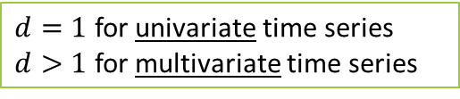

Sequence Data
A Sequence (time series) dataset $T$ is a sequence of $d$-dimensional records$T=<R_{0},…,R_{n−1}>$
where
$R_{i}= (a_{i}^{0},…,a_{i}^{d−1})$is a record $(0≤i≤n−1)$
$a_{i}^{j}$ is $j^{th}$ attribute of $i^{th}$ record
A climate dataset that contains wind speed, snow depth, and temperature over time
$d=1$ for univariate time series
$d>1$ for multivariate time series

Slide 3


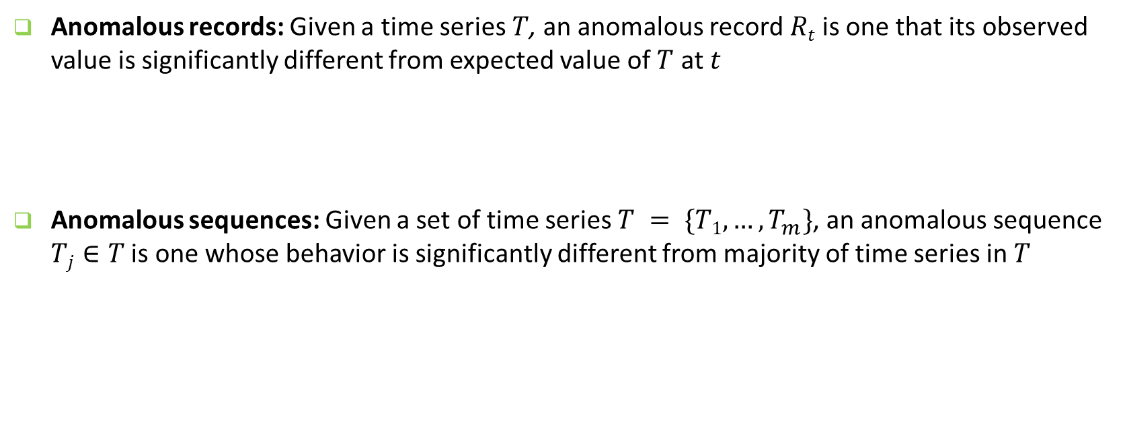
Different Anomalies in Sequence Data
Anomalous records: Given a time series $T$, an anomalous record $Rt$is one that its observed value is significantly different from expected value of $T$ at $t$
Anomalous sequences: Given a set of time series $T = \{T1,…,T_{m}\}$, an anomalous sequence $Tj∈T$ is one whose behavior is significantly different from majority of time series in $T$
An infant patient record with a weight value outside a specific range must be reported as anomalous
A change in upward trend for number of cars passing every second at an intersection from 6 to 7 am on weekdays must be reported as anomalous

Slide 4
Existing Data Quality Test Approaches for Time Series
Anomaly Detection
in
Time-series Data
Anomalous Record Detection
Anomalous Sequence Detection
Time Series Modeling Techniques
Time Series Decomposition Techniques
TCN
Clustering
Autoencoder
LSTM-Autoencoder
Stochastic
Techniques
Machine Learning
Techniques
STL
Vector
Autoregressive
Models (VAR)
Autoregressive
Models (AR)
Moving Average
Models (MA)
ARIMA
Models
HW
IF
MLPs
SANN
LSTM
SVM
HTM
GRU

Slide 5
Datasets
Datasets with both known and injected anomalies
Multivariate NASA Shuttle dataset from UCI ML repository (58,000 records and 8 attributes)
Univariate Yahoo Synthetic Servers datasets (1,420 records and 1 attribute)
Dataset with real-world anomalies
Multivariate Energy data from CSU Energy Institute
1,048,575 records and 2 attributes
0.05% previously known anomalies

Slide 6
Mutation Analysis
Injects mutants as faulty records or sequences that mimic typical anomalies in time-series data
Mutation Operator | Description
𝑀₁–Add noise | Adds random noise to an attribute of randomly selected records from entire dataset.
𝑀₂–Horizontal shift | Shifts attribute values of records in a subset of records along time axis.
𝑀₃–Vertical shift | Adds a random value to all attribute values in a subset of records.
𝑀₄–Re-scale | Multiplies all the attribute values in a subset of records with a random number.
𝑀₅–Add dense noise | Changes all attribute values in a subset of records to randomly selected values.

Slide 8
-what was the surprise in your research
-what if the input data is encrypted?
-what was the most critical anomaly your tool detected?
-Notion of completeness for constraints
-what is your hypothesis?
-how many level of hierarchy your constraints can explain
-why ml?
-deterministic methods do not scale
-how scalable is your approach?
-difference between anomalous, faulty, intrusion,...
-what can be done next?
- What are the other ML approaches for time series/regular data and why you chose these? TCN, HTM
-Autocorrelation finds linear associations between the past values
-How many GPUs you used?
-What was the constraints your approach could find?
-Different concepts:
--fraud detection, intrusion detection vs anomaly detection. Can our approach detect those?
fraud and intrusion are attacks that cause anomalies
-Why do you call it framework

